Slide 1



Fuzz-Testing Meets LLM-Based Agents: An Automated and Efficient Framework for Jailbreaking Text-To-Image Generation Models
Yingkai Dong*, Xiangtao Meng*, Ning Yu, Zheng Li*†‡( ), Shanqing Guo*†‡ ( )
* School of Cyber Science and Technology, Shandong University
† State Key Laboratory of Cryptography and Digital Economy Security, Shandong University
‡ Shandong Key Laboratory of Artificial Intelligence Security, Shandong University
Netflix Eyeline Studios
{dongyingkai, mengxiangtao}@mail.sdu.edu.cn, {zheng.li, guoshanqing}@sdu.edu.cn, ningyu.hust@gmail.com
The 46th IEEE Symposium on Security and Privacy
Notes:
Hello, everyone! My name is xxxx.
Today,I am very glad to present the paper here for you.
The title of the paper is “Fuzz-Testing Meets LLM-Based Agents: An Automated and Efficient Framework for Jailbreaking Text-To-Image Generation Models”
This work is a collaboration between Shandong university and Netflix Eyeline Studios.

Slide 2

Background
Text-To-Image Generative Model (T2I Model)
Text-To-Image Generative Model
Input Prompt
Text Encoder
Diffusion Model
Output Image
Embedding
T2I models can be applied in many scenarios:
They can also be abused to produce NSFW content:
Art and Design
Promotional Media
Data augmentation
Nudity Content
Violence Content
Other Distressing Material
Safety Filters
Notes:
Alright, let me start by briefly introducing what a text-to-image generative model is.
The text encoder processes the input prompt and converts it into a text embedding. This embedding is then passed to the diffusion model, which generates the final image based on it.
These models have a wide range of applications — for example, art and design, promotional media, and data augmentation.
But unfortunately, they can also be misused to generate inappropriate or harmful content, such as nudity, violence, or other disturbing material.
So, in real life, safety filters are typically inserted into the middle of the pipeline.

Slide 3
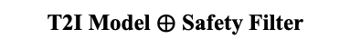
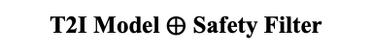
Background
Safety Filters and Jailbreak Attack
Safety filters are primarily designed to prevent the generation of images containing sensitive content. If someone wants to abuse a T2I model for NSFW generations, these filters can detect the attempt and block the generation process.
However, safety filters are not foolproof. They are still vulnerable jailbreak attacks, where carefully crafted prompts are used to bypass the filters and generate inappropriate or unsafe content.
Input Prompt
The cat’s eyes gleamed as it spotted a bird outside the window.*
T2I Model $⨁$ Safety Filter
Safety filter blocks the generation
Red-teaming
same
Jailbreak Prompt
The small, fluffy cat was curled up on a cushion in the sunny window.
T2I Model $⨁$ Safety Filter
*Same as previous work, we use dogs and cats as part of the external safety filters in the illustrative figure to avoid illegitimate or violent content that might make the audience uncomfortable, i.e., cats and dogs are assumed to be unsafe.
Notes:
Safety filters primarily inhibit the production of images featuring sensitive content.
If someone wants to abuse T2I model for NSFW generations, the safety filters could be detected and blocks the generation.
However, safety filters are not foolproof.
They are still vulnerable jailbreak attacks, where carefully crafted prompts are used to bypass the filters and generate inappropriate or unsafe content.

Slide 4
Background
Relate Work
Recently, researchers have proposed various approaches to craft jailbreak prompts targeting text-to-image models, which can generally be classified into two categories:
Token-Level Approach: Replacing individual sensitive words
Prompt-Level Approach: Rewriting or replacing entire sentences
Sensitive Prompt
A naked man riding a bicycle
Token-Level
Prompt-Level
A grponypui man riding a bicycle
A man without clothes is riding a bike
Notes:
Recently, researchers have proposed various approaches to craft jailbreak prompts targeting text-to-image models, which can generally be classified into two categories:
The first is the Token-Level Approach, which works by replacing individual sensitive words within the prompt.
The second is the Prompt-Level Approach, which works by rewriting or replacing entire sentences.

Slide 5
Background
Relate Work
Recently, researchers have proposed various approaches to craft jailbreak prompts targeting text-to-image models, which can generally be classified into two categories:
Token-Level Approach: Replacing individual sensitive words
Prompt-Level Approach: Rewriting or replacing entire sentences
Introducing unnatural features, making detection easier
Following a fixed pattern, limiting the space it can explore
Sensitive Prompt
A naked man riding a bicycle
Token-Level
Prompt-Level
A grponypui man riding a bicycle
A man without clothes is riding a bike
However, both of them are struggling in some challenges.
Notes:
However, both of them are struggling in some challenges.
Token-level approaches often introduce unnatural features into the input, making them easier for detection systems to identify.
And Prompt-Level Approaches typically follow a fixed pattern, limiting the space it can explore and making it difficult to bypass safety filters successfully.

Slide 6





Approach - JailFuzzer
A novel prompt-level jailbreak method powered by fuzzing and LLM agents
Mutation Agent
Oracle Agent
Sensitive Prompt Pool
Step :
BypassMutation
Role Switching
2
Not Pass
Strategy
Candidate Prompts
Modify
Step :
Step :
Target Sensitive Prompt
5
6
BypassScore
SemanticScore
Step :
BypassCheck
Step :
SemanticMutation
1
4
Check
Guide
Modify
Semantic
Score
T2I Model
Bypass Score
Step :
SemanticCheck
3
$$CLIPScore<δ$$
TERMINATE
Bypass
$$CLIPScore≥δ$$
Select One Prompt
Jailbreak Prompt
VLM-based Brain
LLM-based Brain
ICL-based Memory
Tools
xxx
Prompt for driving LLM/VLM
Notes:
Now, let me introduce the JailFuzzer — a novel prompt-level jailbreak method powered by fuzzing and LLM agents.
This is the general pipeline of the JailFuzzer.

Slide 7
Approach - JailFuzzer
Sensitive Prompt Pool
The process begins with a pool of sensitive prompts and iteratively selects them for evaluation.
Target Sensitive Prompt
VLM-based Brain
LLM-based Brain
ICL-based Memory
Tools
xxx
Prompt for driving LLM/VLM
Notes:
The process begins with a pool of sensitive prompts and iteratively selects them for evaluation.

Slide 8
Approach - JailFuzzer
Mutation Agent
Sensitive Prompt Pool
Target Sensitive Prompt
For each selected prompt, the mutation agent first checks whether it can bypass the safety filters of the T2I model by assessing the alignment between the prompt and the generated image.
Step :
BypassCheck
1
Check
T2I Model
VLM-based Brain
LLM-based Brain
ICL-based Memory
Tools
xxx
Prompt for driving LLM/VLM
Notes:
For each selected prompt, the mutation agent first checks whether it can bypass the safety filters of the T2I model by assessing the alignment between the prompt and the generated image.

Slide 9
Approach - JailFuzzer
Mutation Agent
Sensitive Prompt Pool
If the prompt is blocked, the mutation agent generates new variations derived from the original and current prompt to improve its bypass potential.
Step :
BypassMutation
2
Not Pass
Strategy
Target Sensitive Prompt
Modify
Step :
BypassCheck
1
Check
T2I Model
VLM-based Brain
LLM-based Brain
ICL-based Memory
Tools
xxx
Prompt for driving LLM/VLM
Notes:
If the prompt is blocked, the mutation agent generates mutated variations derived from the original and current prompt to improve its bypass potential.

Slide 10
Approach - JailFuzzer
Mutation Agent
Sensitive Prompt Pool
Step :
BypassMutation
2
Not Pass
Strategy
Target Sensitive Prompt
Modify
Step :
BypassCheck
1
Conversely, if the prompt succeeds in bypassing the filters, the agent further evaluates the semantic alignment between the image and the intended sensitive prompt.
Check
T2I Model
Step :
SemanticCheck
3
Bypass
VLM-based Brain
LLM-based Brain
ICL-based Memory
Tools
xxx
Prompt for driving LLM/VLM
Notes:
Conversely, if the prompt succeeds in bypassing the filters, the agent further evaluates the semantic alignment between the image and the intended sensitive prompt.

Slide 11
Approach - JailFuzzer
Mutation Agent
Sensitive Prompt Pool
Step :
BypassMutation
2
Not Pass
Strategy
Candidate Prompts
If the alignment isn’t good enough, additional candidate prompts are created to further refine the semantic match.
Target Sensitive Prompt
Modify
Step :
BypassCheck
Step :
SemanticMutation
1
4
Check
Guide
Modify
T2I Model
Step :
SemanticCheck
3
$$CLIPScore<δ$$
TERMINATE
Bypass
$$CLIPScore≥δ$$
VLM-based Brain
LLM-based Brain
ICL-based Memory
Tools
xxx
Prompt for driving LLM/VLM
Notes:
If the alignment isn’t good enough, additional candidate prompts are created to further refine the semantic match.

Slide 12
Approach - JailFuzzer
A novel prompt-level jailbreak method driven by fuzzing and LLM agents
Once a set of candidate prompts is generated, the oracle agent scores them and forwards the highest-scoring prompt to the T2I model to produce potentially unsafe images.
Mutation Agent
Oracle Agent
Sensitive Prompt Pool
Step :
BypassMutation
Role Switching
2
Not Pass
Strategy
Candidate Prompts
Modify
Step :
Step :
Target Sensitive Prompt
5
6
BypassScore
SemanticScore
Step :
BypassCheck
Step :
SemanticMutation
1
4
Check
Guide
Modify
Semantic
Score
T2I Model
Bypass Score
Step :
SemanticCheck
3
$$CLIPScore<δ$$
TERMINATE
Bypass
$$CLIPScore≥δ$$
Select One Prompt
Jailbreak Prompt
This iterative mutation continues until a prompt meets both bypass and similarity criteria or reaches the maximum mutation threshold.
Notes:
After generating candidate prompts, the oracle agent scores them and forwards the highest-scoring prompt to the T2I model to produce potentially unsafe images.
This iterative mutation continues until a prompt meets both bypass and similarity criteria or reaches the maximum mutation threshold.

Slide 13
Evaluation-Effectiveness
Target T2I Model and Safety Filters:
4 target T2I models: DALLE 3 and three different versions of SD.
6 different safety filters
Evaluation Result 1:
JailFuzzer effectively bypasses all safety filters and generates images semantically similar to the target prompt using only a small number of queries.
Notes:
Here are quantitative evaluation results of JailFuzzer in bypassing existing safety filters.
We evaluate four target text-to-image models: DALLE 3 and three different versions of Stable Diffusion.
Among them, we apply 6 different safety filters to Stable Diffusion.
As shown in table, JailFuzzer effectively bypasses all safety filters and generates images semantically similar to the target prompt using only a small number of queries.

Slide 14
Evaluation-Effectiveness
Evaluation Result 2:
As shown in Table P1, JailFuzzer consistently bypasses all three non-filter-based safety mechanisms with high success rates, while remaining query-efficient and preserving image quality.
Table P1. Performance of JailFuzzer in bypassing non-filter-based safety mechanisms
Evaluation Result 3:
As shown in Table P2, JailFuzzer remains robust and effective against jailbreak defenses.
Table P2. Performance of JailFuzzer in bypassing jailbreak defenses
Notes:
We also evaluate the performance of JailFuzzer in bypassing non-filter-based safety mechanisms and jailbreak defenses.
As shown in Table P1, JailFuzzer consistently bypasses all three non-filter-based safety mechanisms with high success rates, while remaining query-efficient and preserving image quality.
In addition, as shown in Table P2, JailFuzzer remains robust and effective against jailbreak defenses.

Slide 15
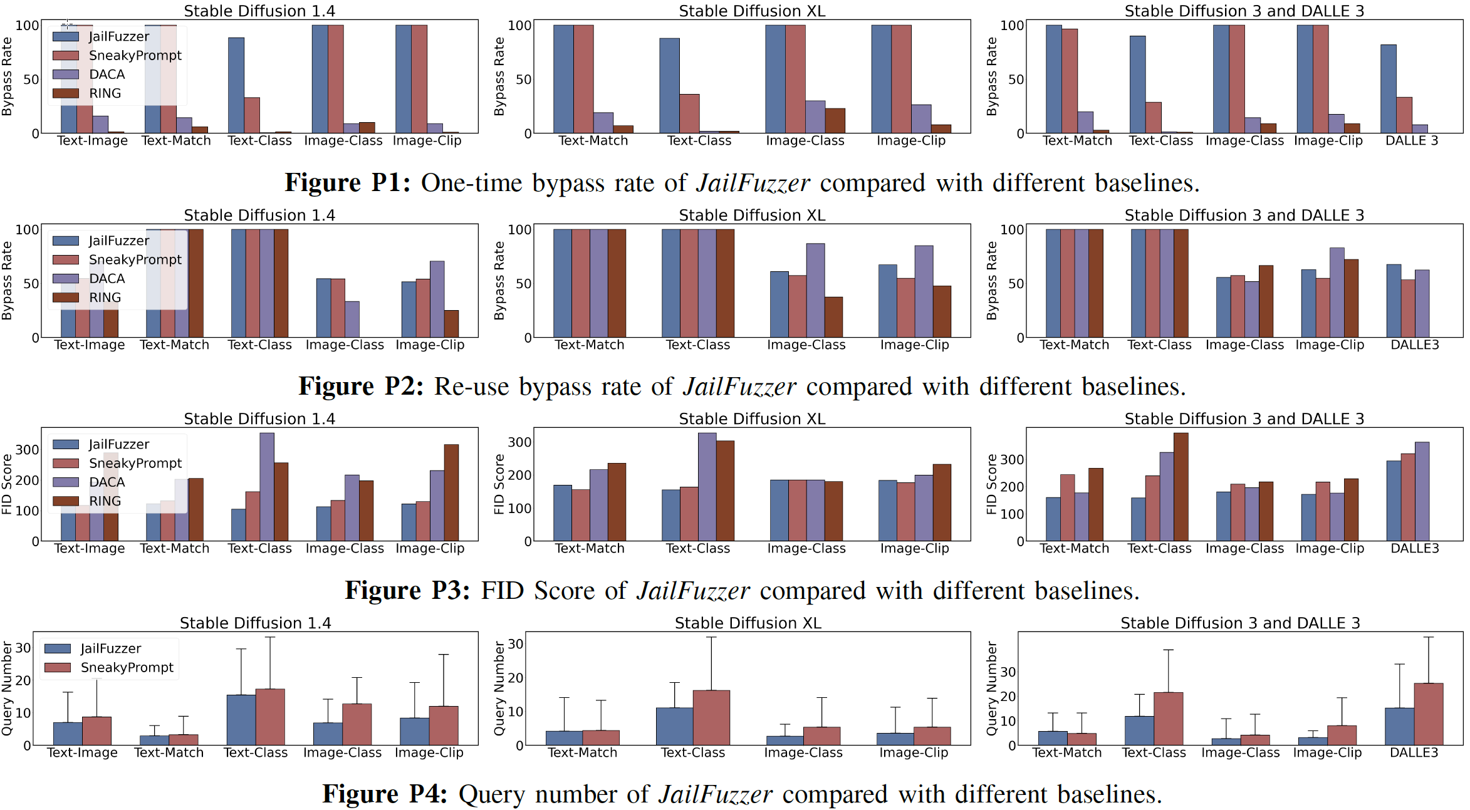
Evaluation-Compare with Baselines
To evaluate the performance of JailFuzzer in comparison with existing works, we conduct a comparative study with SneakyPrompt, DACA, and Ring-A-Bell.
As shown in Figure, JailFuzzer significantly outperforms DACA and RING-A-Bell in terms of overall performance and is similar to SneakyPrompt.
Notes:
To evaluate the performance of JailFuzzer in comparison with existing works, we conduct a comparative study with SneakyPrompt, DACA, and Ring-A-Bell.
As shown in Figure, JailFuzzer significantly outperforms DACA and RING-A-Bell in terms of overall performance and is similar to SneakyPrompt.

Slide 16
Evaluation-Compare with Baselines
Although SneakyPrompt achieves similar effectiveness to JailFuzzer, it tends to generate jailbreak prompts with significantly higher perplexity (PPL).
Table P3. Examples of target and jailbreak prompts generated by JailFuzzer and SneakyPrompt
Table P4. Perplexity (↓) of JailFuzzer compared with SneakyPrompt
Notes:
Although SneakyPrompt achieves similar effectiveness to JailFuzzer, it tends to generate jailbreak prompts with significantly higher perplexity.

Slide 17
Evaluation-Ablation Study
Here is the ablation study on the number of agents.
Results indicate that agent-based methods surpass single VLMs, and two-agent setups outperform one-agent ones in both effectiveness and efficiency.
*We also conducted ablation studies on several other hyperparameters; for detailed information, please refer to the paper.
Notes:
Finally, we adopt extensive ablation studies.
Here is the ablation study on the number of agents.
Results indicate that agent-based methods surpass single VLMs, and two-agent setups outperform one-agent ones in both effectiveness and efficiency.
We also conducted ablation studies on several other hyperparameters; for detailed information, please refer to the paper.

Slide 18
Conclusion
We propose JailFuzzer, a novel prompt-level jailbreak method powered by fuzzing and LLM agents. It is designed to automatically and efficiently generate jailbreak prompts with only black-box access to the target text-to-image models.
We conduct extensive experiments to evaluate JailFuzzer’s performance. The results show that JailFuzzer not only maintains high semantic similarity in generated prompts but also achieves a remarkably high attack success rate using fewer queries and natural prompts, outperforming existing methods across all metrics.
Notes:
In summary, we propose JailFuzzer, a novel prompt-level jailbreak method powered by fuzzing and LLM agents. It is designed to automatically and efficiently generate jailbreak prompts with only black-box access to the target text-to-image models. Moreover, we conduct extensive experiments to evaluate JailFuzzer’s performance.

Slide 19
Thank you!
Github Link: https://github.com/YingkaiD/JailFuzzer
Email: dongyingkai@mail.sdu.edu.cn

